Slide 1
Join vs Subquery

Slide 2
Objectives
In this session, you will learn to:
Query data by using joins

Slide 3
Querying Data by Using Joins
What are Joins?

Slide 4
Querying Data by Using Joins (Contd.)
Joins:
Allow to retrieve data from multiple tables.
Can be of the following types:
Inner join
Outer join
Cross join
Equi join
Self join
Notes:
Student already have learnt about type 2 SCDs in Module I. Therefore, you can start this topic by asking the following questions to students:
What are type 2 SCDs?
Given an example to explain type 2 SCDs.
This will recapitulate what they have learnt about type 2 SCD in Module 1.
Now explain the strategy to update the data into these dimension tables with help the example given in SG.
After explaining the examples, you can ask students to think of an example of a type 2 SCD and then tell the strategy to update the data into this dimension table.

Slide 5
Using an Inner Join
Inner join:
Retrieves records from multiple tables after comparing values present in a common column.
Retrieves only those rows that satisfy the join condition.
Syntax:
SELECT column_name, column_name [,column_name]
FROM table1_name JOIN table2_name
ON table1_name.ref_column_name join_operator table2_name.ref_column_name
Notes:
5
Student already have learnt about type 2 SCDs in Module I. Therefore, you can start this topic by asking the following questions to students:
What are type 2 SCDs?
Given an example to explain type 2 SCDs.
This will recapitulate what they have learnt about type 2 SCD in Module 1.
Now explain the strategy to update the data into these dimension tables with help the example given in SG.
After explaining the examples, you can ask students to think of an example of a type 2 SCD and then tell the strategy to update the data into this dimension table.

Slide 6
Using an Inner Join (Contd.)
Let us now understand the working of inner join.

Slide 7
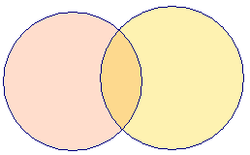
Using an Inner Join (Contd.)
COLUMNS
COLUMNS
A B C
B D E
Table X
Table Y
INNER JOIN
A B C D E
COMMON ROWS
OUTPUT
Notes:
Explain the diagram to the students. Tell them that, in the above diagram you can see that the common data from both the tables, Table X and Table Y is displayed. The data is displayed on the base of a common column, Column B.

Slide 8
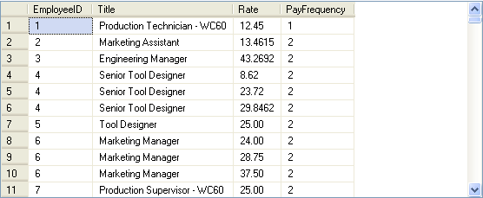
Using an Inner Join (Contd.)
For example:
SELECT e.EmployeeID,e.Title, eph.Rate,eph.PayFrequency
FROM HumanResources.Employee e JOIN HumanResources.EmployeePayHistory eph ON e.EmployeeID = eph.EmployeeID
Output
Employee table
EmployeePayHistory table
Notes:
You can summarize the session by running through the summary given in SG.
In addition, you can also ask students summarize what they have learnt in this session.

Slide 9
Using an Inner Join (Contd.)
An inner join is the default join. Therefore, you can also apply an inner join by using the JOIN keyword.

Slide 10
Just a minute
Why do you need a table alias with the column name?
Solution:
A table alias is required to uniquely identify columns in the SELECT query to avoid ambiguity that arises due to same column names in multiple tables.
Notes:
Student already have learnt about type 2 SCDs in Module I. Therefore, you can start this topic by asking the following questions to students:
What are type 2 SCDs?
Given an example to explain type 2 SCDs.
This will recapitulate what they have learnt about type 2 SCD in Module 1.
Now explain the strategy to update the data into these dimension tables with help the example given in SG.
After explaining the examples, you can ask students to think of an example of a type 2 SCD and then tell the strategy to update the data into this dimension table.

Slide 11
Using an Outer Join
Outer join:
Displays the result set containing all the rows from one table and the matching rows from another table.
Displays NULL for the columns of the related table where it does not find matching records.
Is of the following types:
Left outer join
Right outer join
Full outer join
Notes:
11
Student already have learnt about type 2 SCDs in Module I. Therefore, you can start this topic by asking the following questions to students:
What are type 2 SCDs?
Given an example to explain type 2 SCDs.
This will recapitulate what they have learnt about type 2 SCD in Module 1.
Now explain the strategy to update the data into these dimension tables with help the example given in SG.
After explaining the examples, you can ask students to think of an example of a type 2 SCD and then tell the strategy to update the data into this dimension table.

Slide 12
Using an Outer Join (Contd.)
Let us now understand how different types of outer joins work.

Slide 13

Using an Outer Join (Contd.)
COLUMNS
COLUMNS
A B C
B D E
Table X
Table Y
LEFT OUTER JOIN
A B C D E
ALL ROWS FROM TABLE X AND COMMON ROWS FROM TABLE Y
OUTPUT
Notes:
Explain the concept of the LEFT OUTER JOIN to the students using the diagram. Tell them, that as shown in the figure all the rows from first table, Table X are displayed. However, only the matching rows from the second table, Table Y, are displayed. Also tell them that the data is based on the common column between the tables, Column B.

Slide 14
Using an Outer Join (Contd.)
COLUMNS
COLUMNS
A B C
B D E
Table X
Table Y
RIGHT OUTER JOIN
A B C D E
ALL ROWS FROM TABLE Y AND COMMON ROWS FROM TABLE X
OUTPUT
Notes:
Explain the concept of the RIGHT OUTER JOIN to the students using the diagram. Tell them, that as shown in the figure all the rows from second table, Table Y are displayed. However, only the matching rows from the first table, Table X, are displayed. Also tell them that the data is based on the common column between the tables, Column B.

Slide 15
Using an Outer Join (Contd.)
COLUMNS
COLUMNS
A B C
B D E
Table X
Table Y
FULL OUTER JOIN
A B C D E
ALL ROWS FROM TABLE Y AND TABLE Y AND COMMON ROWS ONLY ONCE
OUTPUT
Notes:
Explain the concept of the FULL OUTER join to the students. Tell them that full outer join is a combination of LEFT OUTER join and RIGHT OUTER join. This join returns all the matching and non-matching rows from both the tables.

Slide 16
Using an Outer Join (Contd.)
Syntax:
SELECT column_name, column_name [,column_name]
FROM table1_name [LEFT | RIGHT| FULL] OUTER JOIN table2_name ON table1_name.ref_column_name join_operator table2_name.ref_column_name
Notes:
16
Student already have learnt about type 2 SCDs in Module I. Therefore, you can start this topic by asking the following questions to students:
What are type 2 SCDs?
Given an example to explain type 2 SCDs.
This will recapitulate what they have learnt about type 2 SCD in Module 1.
Now explain the strategy to update the data into these dimension tables with help the example given in SG.
After explaining the examples, you can ask students to think of an example of a type 2 SCD and then tell the strategy to update the data into this dimension table.

Slide 17
Using an Outer Join (Contd.)
Left outer join:
Returns all rows from the table specified on the left side of the LEFT OUTER JOIN keyword and the matching rows from the table specified on the right side.
Displays NULL for the columns of the table specified on the right side where it does not find matching records.
For example:
SELECT DISTINCT (p.ProductID), p1.SpecialOfferID,
p1.SalesOrderID, p1.OrderQty, p1.UnitPrice
FROM Sales.SpecialOfferProduct p LEFT OUTER JOIN
[Sales].[SalesOrderDetail] p1 ON p.ProductID
=p1.ProductID
ORDER BY p.ProductID
Notes:
17
Student already have learnt about type 2 SCDs in Module I. Therefore, you can start this topic by asking the following questions to students:
What are type 2 SCDs?
Given an example to explain type 2 SCDs.
This will recapitulate what they have learnt about type 2 SCD in Module 1.
Now explain the strategy to update the data into these dimension tables with help the example given in SG.
After explaining the examples, you can ask students to think of an example of a type 2 SCD and then tell the strategy to update the data into this dimension table.

Slide 18
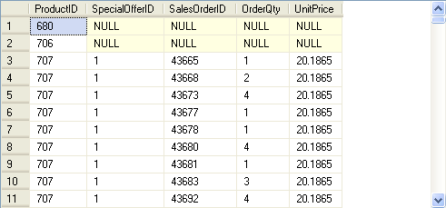
Using an Outer Join (Contd.)
The following figure displays the output of the preceding query.
Displays NULL for the ProductIDs for which no transaction was performed.
Notes:
18
Student already have learnt about type 2 SCDs in Module I. Therefore, you can start this topic by asking the following questions to students:
What are type 2 SCDs?
Given an example to explain type 2 SCDs.
This will recapitulate what they have learnt about type 2 SCD in Module 1.
Now explain the strategy to update the data into these dimension tables with help the example given in SG.
After explaining the examples, you can ask students to think of an example of a type 2 SCD and then tell the strategy to update the data into this dimension table.

Slide 19
Using an Outer Join (Contd.)
Right outer join:
Returns all the rows from the table specified on the right side of the RIGHT OUTER JOIN keyword.
Returns the matching rows from the table specified on the left side.
For example:
SELECT st.Name AS Territory, sp.SalesPersonID
FROM Sales.SalesTerritory st
RIGHT OUTER JOIN Sales.SalesPerson sp
ON st.TerritoryID = sp.TerritoryID
Notes:
19
Student already have learnt about type 2 SCDs in Module I. Therefore, you can start this topic by asking the following questions to students:
What are type 2 SCDs?
Given an example to explain type 2 SCDs.
This will recapitulate what they have learnt about type 2 SCD in Module 1.
Now explain the strategy to update the data into these dimension tables with help the example given in SG.
After explaining the examples, you can ask students to think of an example of a type 2 SCD and then tell the strategy to update the data into this dimension table.

Slide 20
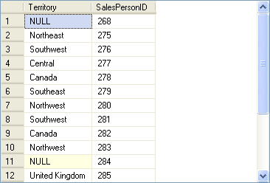
Using an Outer Join (Contd.)
The following figure displays the output of the preceding query.
Displays NULL in the Territory column for those sales persons who have not been assigned any territory.
Notes:
20
Student already have learnt about type 2 SCDs in Module I. Therefore, you can start this topic by asking the following questions to students:
What are type 2 SCDs?
Given an example to explain type 2 SCDs.
This will recapitulate what they have learnt about type 2 SCD in Module 1.
Now explain the strategy to update the data into these dimension tables with help the example given in SG.
After explaining the examples, you can ask students to think of an example of a type 2 SCD and then tell the strategy to update the data into this dimension table.

Slide 21
Using an Outer Join (Contd.)
Full outer join:
Is a combination of left outer join and right outer join.
Returns all the matching and non-matching rows from both the tables.
For example:
SELECT st.Name AS Territory, sp.SalesPersonID
FROM Sales.SalesTerritory st
FULL OUTER JOIN Sales.SalesPerson sp
ON st.TerritoryID = sp.TerritoryID
Notes:
21
Student already have learnt about type 2 SCDs in Module I. Therefore, you can start this topic by asking the following questions to students:
What are type 2 SCDs?
Given an example to explain type 2 SCDs.
This will recapitulate what they have learnt about type 2 SCD in Module 1.
Now explain the strategy to update the data into these dimension tables with help the example given in SG.
After explaining the examples, you can ask students to think of an example of a type 2 SCD and then tell the strategy to update the data into this dimension table.

Slide 22
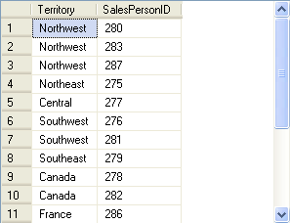
Using an Outer Join (Contd.)
The following figure displays the output of the preceding query.
Displays NULL values in the SalesPersonID column for those territories which have not been assigned to any sales person.
Displays NULL values in the Territory column for those sales persons who have not been assigned any territory.
Notes:
22
Student already have learnt about type 2 SCDs in Module I. Therefore, you can start this topic by asking the following questions to students:
What are type 2 SCDs?
Given an example to explain type 2 SCDs.
This will recapitulate what they have learnt about type 2 SCD in Module 1.
Now explain the strategy to update the data into these dimension tables with help the example given in SG.
After explaining the examples, you can ask students to think of an example of a type 2 SCD and then tell the strategy to update the data into this dimension table.

Slide 23
Just a minute
When do you use the right outer join?
Solution:
You can use the right outer join when you need all the records from the table at the right side of the outer join and only matching records from the table at the left side of the outer join.
Notes:
Student already have learnt about type 2 SCDs in Module I. Therefore, you can start this topic by asking the following questions to students:
What are type 2 SCDs?
Given an example to explain type 2 SCDs.
This will recapitulate what they have learnt about type 2 SCD in Module 1.
Now explain the strategy to update the data into these dimension tables with help the example given in SG.
After explaining the examples, you can ask students to think of an example of a type 2 SCD and then tell the strategy to update the data into this dimension table.

Slide 24
Using a Cross Join
Cross join:
Is also known as the Cartesian Product.
Joins each row from one table with each row of the other table.
Let us now understand the working of cross join.
Notes:
24
Student already have learnt about type 2 SCDs in Module I. Therefore, you can start this topic by asking the following questions to students:
What are type 2 SCDs?
Given an example to explain type 2 SCDs.
This will recapitulate what they have learnt about type 2 SCD in Module 1.
Now explain the strategy to update the data into these dimension tables with help the example given in SG.
After explaining the examples, you can ask students to think of an example of a type 2 SCD and then tell the strategy to update the data into this dimension table.

Slide 25
Using a Cross Join (Contd.)
COLUMNS
COLUMNS
A B C
B D E
Table X
Table Y
CROSS JOIN
m ROWS
n ROWS
A B C D E
ALL ROWS (n X m)
EACH ROW OF TABLE X JOINED WITH EACH ROW OF TABLE Y
OUTPUT
Notes:
Explain the concept of CROSS JOIN to the students. Tell them that CROSS JOIN displays a combination of all the rows from one table with all the rows from the other one. Also tell them that it shows the Cartesian Product between the rows of first and second table.
FAQs
Question: What is the difference between FULL OUTER JOIN and CROSS JOIN?
Answer: A FULL OUTER JOIN displays all matching and non-matching rows from both the tables and displays NULL in place of non-matching rows. Whereas, a CROSS JOIN displays all the possible combination of all the rows in both the tables.
Additional Input
A Cartesian Product is the set of all possible ordered pairs between two sets.

Slide 26
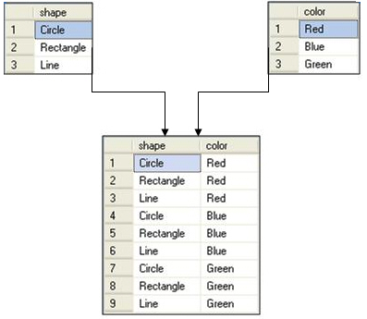
Using a Cross Join (Contd.)
For example, consider the following figure.
The result set contains nine rows.
Notes:
Student already have learnt about type 2 SCDs in Module I. Therefore, you can start this topic by asking the following questions to students:
What are type 2 SCDs?
Given an example to explain type 2 SCDs.
This will recapitulate what they have learnt about type 2 SCD in Module 1.
Now explain the strategy to update the data into these dimension tables with help the example given in SG.
After explaining the examples, you can ask students to think of an example of a type 2 SCD and then tell the strategy to update the data into this dimension table.

Slide 27
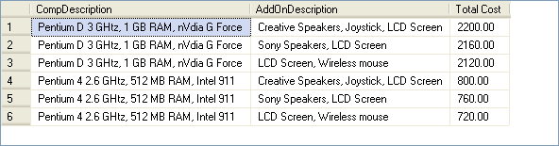
Using a Cross Join (Contd.)
Consider the following query:
SELECT A.CompDescription, B.AddOnDescription, A.Price + B.Price AS 'Total Cost' FROM ComputerDetails A CROSS JOIN AddOnDetails B
Output
Combines the records of both the tables to display the total price of a computer with all the possible combinations.
Notes:
Student already have learnt about type 2 SCDs in Module I. Therefore, you can start this topic by asking the following questions to students:
What are type 2 SCDs?
Given an example to explain type 2 SCDs.
This will recapitulate what they have learnt about type 2 SCD in Module 1.
Now explain the strategy to update the data into these dimension tables with help the example given in SG.
After explaining the examples, you can ask students to think of an example of a type 2 SCD and then tell the strategy to update the data into this dimension table.

Slide 28
Using an Equi Join
Equi join:
Is the same as an inner join and joins tables with the help of a foreign key.
Is used to display all the columns from both the tables.
Let us now understand the working of an equi join.
Notes:
28
Student already have learnt about type 2 SCDs in Module I. Therefore, you can start this topic by asking the following questions to students:
What are type 2 SCDs?
Given an example to explain type 2 SCDs.
This will recapitulate what they have learnt about type 2 SCD in Module 1.
Now explain the strategy to update the data into these dimension tables with help the example given in SG.
After explaining the examples, you can ask students to think of an example of a type 2 SCD and then tell the strategy to update the data into this dimension table.

Slide 29
Using an Equi Join (Contd.)
COLUMNS
COLUMNS
A B C
B D E
Table X
Table Y
EQUI JOIN
A B C D B E
COMMON ROWS
OUTPUT
Notes:
Explain the concept of EQUI join to the student.

Slide 30
Using an Equi Join (Contd.)
For example:
SELECT * FROM HumanResources.EmployeeDepartmentHistory d JOIN HumanResources.Employee e ON d.EmployeeID = e.EmployeeID JOIN HumanResources.Department p ON p.DepartmentID = d.DepartmentID
Notes:
30
Student already have learnt about type 2 SCDs in Module I. Therefore, you can start this topic by asking the following questions to students:
What are type 2 SCDs?
Given an example to explain type 2 SCDs.
This will recapitulate what they have learnt about type 2 SCD in Module 1.
Now explain the strategy to update the data into these dimension tables with help the example given in SG.
After explaining the examples, you can ask students to think of an example of a type 2 SCD and then tell the strategy to update the data into this dimension table.

Slide 31
Using an Equi Join (Contd.)
For example:
SELECT * FROM HumanResources.EmployeeDepartmentHistory d JOIN HumanResources.Employee e ON d.EmployeeID = e.EmployeeID JOIN HumanResources.Department p ON p.DepartmentID = d.DepartmentID
Applies an equi join between the EmployeeDepartmentHistory, Employee, and Department tables by using a common column, EmployeeID.
Notes:
31
Student already have learnt about type 2 SCDs in Module I. Therefore, you can start this topic by asking the following questions to students:
What are type 2 SCDs?
Given an example to explain type 2 SCDs.
This will recapitulate what they have learnt about type 2 SCD in Module 1.
Now explain the strategy to update the data into these dimension tables with help the example given in SG.
After explaining the examples, you can ask students to think of an example of a type 2 SCD and then tell the strategy to update the data into this dimension table.

Slide 32
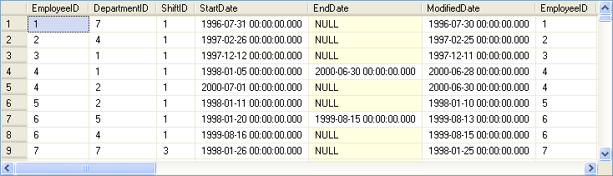
Using an Equi Join (Contd.)
The following figure displays the output of the preceding query.
Displays the EmployeeID column from all the tables.
Notes:
32
Student already have learnt about type 2 SCDs in Module I. Therefore, you can start this topic by asking the following questions to students:
What are type 2 SCDs?
Given an example to explain type 2 SCDs.
This will recapitulate what they have learnt about type 2 SCD in Module 1.
Now explain the strategy to update the data into these dimension tables with help the example given in SG.
After explaining the examples, you can ask students to think of an example of a type 2 SCD and then tell the strategy to update the data into this dimension table.

Slide 33
Just a minute
What is the difference between an equi join and an inner join?
Solution:
In an equi join, you can use only the equality operator to specify the join condition, whereas in an inner join you have the flexibility to use other conditional operators.
Notes:
Student already have learnt about type 2 SCDs in Module I. Therefore, you can start this topic by asking the following questions to students:
What are type 2 SCDs?
Given an example to explain type 2 SCDs.
This will recapitulate what they have learnt about type 2 SCD in Module 1.
Now explain the strategy to update the data into these dimension tables with help the example given in SG.
After explaining the examples, you can ask students to think of an example of a type 2 SCD and then tell the strategy to update the data into this dimension table.

Slide 34
Using a Self Join
Self join:
A table is joined with itself.
One row in a table correlates with other rows in the same table.
A table name is used twice by giving two alias names in the query.
Notes:
34
Student already have learnt about type 2 SCDs in Module I. Therefore, you can start this topic by asking the following questions to students:
What are type 2 SCDs?
Given an example to explain type 2 SCDs.
This will recapitulate what they have learnt about type 2 SCD in Module 1.
Now explain the strategy to update the data into these dimension tables with help the example given in SG.
After explaining the examples, you can ask students to think of an example of a type 2 SCD and then tell the strategy to update the data into this dimension table.

Slide 35
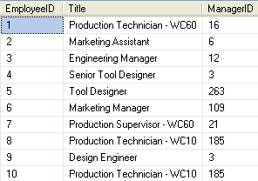
Using a Self Join (Contd.)
Consider the Employee table, as shown in the following figure.
Notes:
35
Student already have learnt about type 2 SCDs in Module I. Therefore, you can start this topic by asking the following questions to students:
What are type 2 SCDs?
Given an example to explain type 2 SCDs.
This will recapitulate what they have learnt about type 2 SCD in Module 1.
Now explain the strategy to update the data into these dimension tables with help the example given in SG.
After explaining the examples, you can ask students to think of an example of a type 2 SCD and then tell the strategy to update the data into this dimension table.

Slide 36
Using a Self Join (Contd.)
To display the employee details along with their manager details, you can use a self join.

Slide 37
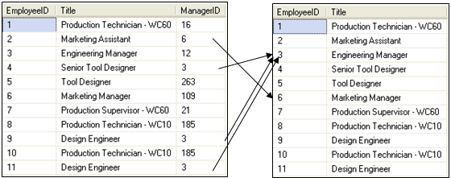
Using a Self Join (Contd.)
To perform self-join, you need to divide the physical tables into two logical tables, as shown in the following figure.
Employee (emp)
Employee (mgr)
Emp.ManagerID = mgr.EmployeeID
Notes:
37
Student already have learnt about type 2 SCDs in Module I. Therefore, you can start this topic by asking the following questions to students:
What are type 2 SCDs?
Given an example to explain type 2 SCDs.
This will recapitulate what they have learnt about type 2 SCD in Module 1.
Now explain the strategy to update the data into these dimension tables with help the example given in SG.
After explaining the examples, you can ask students to think of an example of a type 2 SCD and then tell the strategy to update the data into this dimension table.

Slide 38
Using a Self Join (Contd.)
The following query joins the Employee table with itself:
SELECT emp.EmployeeID, emp.Title AS Employee_Designation, emp.ManagerID, mgr.Title AS Manager_Designation FROM HumanResources.Employee emp, HumanResources.Employee mgr WHERE emp.ManagerID = mgr.EmployeeID
Notes:
38
Student already have learnt about type 2 SCDs in Module I. Therefore, you can start this topic by asking the following questions to students:
What are type 2 SCDs?
Given an example to explain type 2 SCDs.
This will recapitulate what they have learnt about type 2 SCD in Module 1.
Now explain the strategy to update the data into these dimension tables with help the example given in SG.
After explaining the examples, you can ask students to think of an example of a type 2 SCD and then tell the strategy to update the data into this dimension table.

Slide 39
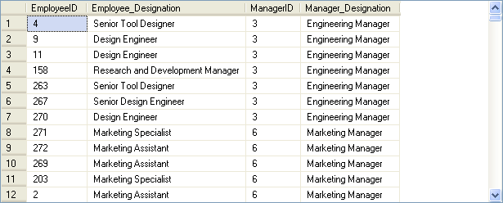
Using a Self Join (Contd.)
The output of the preceding query is shown in the following figure.
Notes:
39
Student already have learnt about type 2 SCDs in Module I. Therefore, you can start this topic by asking the following questions to students:
What are type 2 SCDs?
Given an example to explain type 2 SCDs.
This will recapitulate what they have learnt about type 2 SCD in Module 1.
Now explain the strategy to update the data into these dimension tables with help the example given in SG.
After explaining the examples, you can ask students to think of an example of a type 2 SCD and then tell the strategy to update the data into this dimension table.

Slide 40
Demo: Using Joins
Problem Statement:
The HR manager of AdventureWorks, Inc. requires a report containing the following details:
Employee ID
Employee name
Department name
Date of joining
Employee address
How will you generate this report?
Notes:
You can summarize the session by running through the summary given in SG.
In addition, you can also ask students summarize what they have learnt in this session.

Slide 41
Demo: Using Joins (Contd.)
Solution:
To generate the required report, you need to perform the following tasks:
1. Identify the join.
2. Create a query based on the identified join.
3. Execute the query to verify the result.
Notes:
You can summarize the session by running through the summary given in SG.
In addition, you can also ask students summarize what they have learnt in this session.

Slide 42
Summary
In this session, you learned that:
Joins and subqueries are used to retrieve data from multiple tables.
An inner join combines records from multiple tables by using a comparison operator on a common column.
A left outer join returns all the rows from the left table and the matching rows from the right table.
A right outer join returns all the rows from the right table and the matching rows from the left table.
A full outer join returns all the matching and non-matching rows from both the tables on which the join is applied.
A cross join returns each row from the first table joined with each row from the second table.
Notes:
You can summarize the session by running through the summary given in SG.
In addition, you can also ask students summarize what they have learnt in this session.

Slide 43
Summary (Contd.)
In an equi join, only the equality operator is used to specify the join condition.
A self join correlates one row in a table with other rows in the same table.
Notes:
You can summarize the session by running through the summary given in SG.
In addition, you can also ask students summarize what they have learnt in this session.

Slide 44
Objectives
In this session, you will learn to:
Query data by using subqueries

Slide 45
Querying Data by Using Subqueries
Subquery:
Is an SQL statement that is used within another SQL statement.
Is nested inside the WHERE or HAVING clause of the SELECT, INSERT, UPDATE, and DELETE statements.
For example:
SELECT * FROM EmployeeDetails WHERE Designation = (SELECT Designation FROM EmployeeDetails WHERE EmpName = 'John')
Notes:
You can summarize the session by running through the summary given in SG.
In addition, you can also ask students summarize what they have learnt in this session.

Slide 46
Querying Data by Using Subqueries (Contd.)
Subquery:
Is an SQL statement that is used within another SQL statement.
Is nested inside the WHERE or HAVING clause of the SELECT, INSERT, UPDATE, and DELETE statements.
For example:
SELECT * FROM EmployeeDetails WHERE Designation = (SELECT Designation FROM EmployeeDetails WHERE EmpName = 'John')
Represents the parent query and is called an outer query.
Notes:
You can summarize the session by running through the summary given in SG.
In addition, you can also ask students summarize what they have learnt in this session.

Slide 47
Querying Data by Using Subqueries (Contd.)
Subquery:
Is an SQL statement that is used within another SQL statement.
Is nested inside the WHERE or HAVING clause of the SELECT, INSERT, UPDATE, and DELETE statements.
For example:
SELECT * FROM EmployeeDetails WHERE Designation = (SELECT Designation FROM EmployeeDetails WHERE EmpName = 'John')
Represents the subquery and is called an inner query.
Notes:
You can summarize the session by running through the summary given in SG.
In addition, you can also ask students summarize what they have learnt in this session.

Slide 48

Querying Data by Using Subqueries (Contd.)
The following figure displays the output of the preceding query.
Notes:
You can summarize the session by running through the summary given in SG.
In addition, you can also ask students summarize what they have learnt in this session.

Slide 49
Using the IN and EXISTS Keywords
You can specify different kinds of conditions on subqueries by using the following keywords:
IN
EXISTS
Notes:
You can summarize the session by running through the summary given in SG.
In addition, you can also ask students summarize what they have learnt in this session.

Slide 50
Using the IN and EXISTS Keywords (Contd.)
IN keyword:
Is used to retrieve rows in a subquery based on the match of values given in a list.
Syntax:
SELECT column, column [,column] FROM table_name WHERE column [ NOT ] IN ( SELECT column FROM table_name [WHERE conditional_expression] )
For example:
SELECT EmployeeID FROM HumanResources.EmployeeAddress WHERE AddressID IN (SELECT AddressID FROM Person.Address WHERE City = 'Bothell')
Notes:
You can summarize the session by running through the summary given in SG.
In addition, you can also ask students summarize what they have learnt in this session.

Slide 51
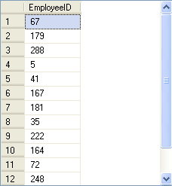
Using the IN and EXISTS Keywords (Contd.)
The following figure displays the output of the preceding query.
Retrieves the EmployeeID attribute of all the employees, who live in Bothell, from the EmployeeAddress table.
Notes:
You can summarize the session by running through the summary given in SG.
In addition, you can also ask students summarize what they have learnt in this session.

Slide 52
Using the IN and EXISTS Keywords (Contd.)
EXISTS keyword:
Is used to check the existence of the data and returns true or false.
Syntax:
SELECT column, column [,column] FROM table_name WHERE EXISTS ( SELECT column FROM table_name [ WHERE conditional_expression] )
For example:
SELECT EmployeeID, Title FROM HumanResources.Employee WHERE EXISTS (SELECT * FROM HumanResources.EmployeeDepartmentHistory WHERE EmployeeID = HumanResources.Employee.EmployeeID AND DepartmentID = 4)
Notes:
You can summarize the session by running through the summary given in SG.
In addition, you can also ask students summarize what they have learnt in this session.

Slide 53
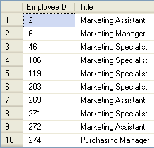
Using the IN and EXISTS Keywords (Contd.)
The following figure displays the output of the preceding query.
Retrieves the employee ID and title of all the employees who have worked in the marketing department at any point of time.
Notes:
You can summarize the session by running through the summary given in SG.
In addition, you can also ask students summarize what they have learnt in this session.

Slide 54
Using Modified Comparison Operators
The ALL and ANY keywords can be used to modify the existing comparison operators.
Notes:
54
Student already have learnt about type 2 SCDs in Module I. Therefore, you can start this topic by asking the following questions to students:
What are type 2 SCDs?
Given an example to explain type 2 SCDs.
This will recapitulate what they have learnt about type 2 SCD in Module 1.
Now explain the strategy to update the data into these dimension tables with help the example given in SG.
After explaining the examples, you can ask students to think of an example of a type 2 SCD and then tell the strategy to update the data into this dimension table.

Slide 55
Using Modified Comparison Operators (Contd.)
The ALL keyword:
Returns a TRUE value if all the values that are retrieved by the subquery satisfy the comparison operator.
The ANY keyword:
Returns a TRUE value, if any value that is retrieved by the subquery satisfies the comparison operator.
Notes:
55
Student already have learnt about type 2 SCDs in Module I. Therefore, you can start this topic by asking the following questions to students:
What are type 2 SCDs?
Given an example to explain type 2 SCDs.
This will recapitulate what they have learnt about type 2 SCD in Module 1.
Now explain the strategy to update the data into these dimension tables with help the example given in SG.
After explaining the examples, you can ask students to think of an example of a type 2 SCD and then tell the strategy to update the data into this dimension table.

Slide 56
Using Modified Comparison Operators (Contd.)
The following table shows the operators that can be used with the ALL and ANY keywords.
Operator | Description
>ALL | Means greater than the maximum value in the list. The expression | column_name >ALL (10, 20, 30) means ‘greater than 30’
>ANY | Means greater than the minimum value in the list. The expression | column_name >ANY (10, 20, 30) means ‘greater than 10’
=ANY | Means any of the values in the list. It acts in the same way as the IN clause. The expression | column_name =ANY (10, 20, 30) means ‘equal to either 10 or 20 or 30’
<>ANY | Means not equal to any value in the list. The expression | column_name <>ANY (10, 20, 30) means ‘not equal to 10 or 20 or 30’
<>ALL | Means not equal to all the values in the list. It acts in the same way as the NOT IN clause. The expression | column_name <>ALL (10, 20, 30) means ‘not equal to 10 and 20 and 30’
Notes:
56
Student already have learnt about type 2 SCDs in Module I. Therefore, you can start this topic by asking the following questions to students:
What are type 2 SCDs?
Given an example to explain type 2 SCDs.
This will recapitulate what they have learnt about type 2 SCD in Module 1.
Now explain the strategy to update the data into these dimension tables with help the example given in SG.
After explaining the examples, you can ask students to think of an example of a type 2 SCD and then tell the strategy to update the data into this dimension table.

Slide 57
Using Modified Comparison Operators (Contd.)
The following query displays the employee ID and the title of all the employees whose vacation hours are more than the vacation hours of employees designated as Recruiter:
SELECT EmployeeID, Title
FROM HumanResources.Employee
WHERE VacationHours >ALL (SELECT VacationHours
FROM HumanResources.Employee WHERE Title
= 'Recruiter')
Notes:
57
Student already have learnt about type 2 SCDs in Module I. Therefore, you can start this topic by asking the following questions to students:
What are type 2 SCDs?
Given an example to explain type 2 SCDs.
This will recapitulate what they have learnt about type 2 SCD in Module 1.
Now explain the strategy to update the data into these dimension tables with help the example given in SG.
After explaining the examples, you can ask students to think of an example of a type 2 SCD and then tell the strategy to update the data into this dimension table.

Slide 58
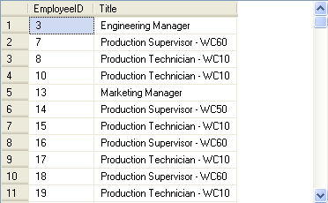
Using Modified Comparison Operators (Contd.)
The following figure displays the output of the preceding query.
Notes:
58
Student already have learnt about type 2 SCDs in Module I. Therefore, you can start this topic by asking the following questions to students:
What are type 2 SCDs?
Given an example to explain type 2 SCDs.
This will recapitulate what they have learnt about type 2 SCD in Module 1.
Now explain the strategy to update the data into these dimension tables with help the example given in SG.
After explaining the examples, you can ask students to think of an example of a type 2 SCD and then tell the strategy to update the data into this dimension table.

Slide 59
Just a minute
What is the use of the EXISTS keyword in a subquery?
Solution:
The EXISTS keyword is used to check the existence of rows in the result set of an inner query according to the condition specified in the inner query.
Notes:
Student already have learnt about type 2 SCDs in Module I. Therefore, you can start this topic by asking the following questions to students:
What are type 2 SCDs?
Given an example to explain type 2 SCDs.
This will recapitulate what they have learnt about type 2 SCD in Module 1.
Now explain the strategy to update the data into these dimension tables with help the example given in SG.
After explaining the examples, you can ask students to think of an example of a type 2 SCD and then tell the strategy to update the data into this dimension table.

Slide 60
Using Aggregate Functions
Aggregate functions:
Can be used to generate aggregate values from the inner query.
For example:
SELECT EmployeeId FROM HumanResources.Employee
WHERE VacationHours >(SELECT AVG(VacationHours) FROM HumanResources.Employee
WHERE Title = 'Marketing Assistant')
Notes:
60
Student already have learnt about type 2 SCDs in Module I. Therefore, you can start this topic by asking the following questions to students:
What are type 2 SCDs?
Given an example to explain type 2 SCDs.
This will recapitulate what they have learnt about type 2 SCD in Module 1.
Now explain the strategy to update the data into these dimension tables with help the example given in SG.
After explaining the examples, you can ask students to think of an example of a type 2 SCD and then tell the strategy to update the data into this dimension table.

Slide 61
Using Aggregate Functions (Contd.)
Aggregate functions:
Can be used to generate aggregate values from the inner query.
For example:
SELECT EmployeeId FROM HumanResources.Employee
WHERE VacationHours >(SELECT AVG(VacationHours) FROM HumanResources.Employee
WHERE Title = 'Marketing Assistant')
The inner query returns the average vacation hours of all the employees who are titled as Marketing Assistant.
Notes:
61
Student already have learnt about type 2 SCDs in Module I. Therefore, you can start this topic by asking the following questions to students:
What are type 2 SCDs?
Given an example to explain type 2 SCDs.
This will recapitulate what they have learnt about type 2 SCD in Module 1.
Now explain the strategy to update the data into these dimension tables with help the example given in SG.
After explaining the examples, you can ask students to think of an example of a type 2 SCD and then tell the strategy to update the data into this dimension table.

Slide 62
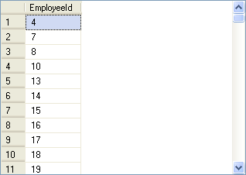
Using Aggregate Functions (Contd.)
The following figure displays the output of the preceding query.
Notes:
62
Student already have learnt about type 2 SCDs in Module I. Therefore, you can start this topic by asking the following questions to students:
What are type 2 SCDs?
Given an example to explain type 2 SCDs.
This will recapitulate what they have learnt about type 2 SCD in Module 1.
Now explain the strategy to update the data into these dimension tables with help the example given in SG.
After explaining the examples, you can ask students to think of an example of a type 2 SCD and then tell the strategy to update the data into this dimension table.

Slide 63
Using Nested Subqueries
Nested subqueries:
Contain one or more subqueries.
Can be used when the condition of a query is dependent on the result of another query.
For example:
SELECT DepartmentID FROM HumanResources.EmployeeDepartmentHistory
WHERE EmployeeID =
(SELECT EmployeeID FROM HumanResources.Employee
WHERE ContactID =
(SELECT ContactID FROM Person.Contact WHERE EmailAddress = 'taylor0@adventure-works.com')
)
Notes:
63
Student already have learnt about type 2 SCDs in Module I. Therefore, you can start this topic by asking the following questions to students:
What are type 2 SCDs?
Given an example to explain type 2 SCDs.
This will recapitulate what they have learnt about type 2 SCD in Module 1.
Now explain the strategy to update the data into these dimension tables with help the example given in SG.
After explaining the examples, you can ask students to think of an example of a type 2 SCD and then tell the strategy to update the data into this dimension table.

Slide 64
Using Nested Subqueries (Contd.)
Nested subqueries:
Contain one or more subqueries.
Can be used when the condition of a query is dependent on the result of another query.
For example:
SELECT DepartmentID FROM HumanResources.EmployeeDepartmentHistory
WHERE EmployeeID =
(SELECT EmployeeID FROM HumanResources.Employee
WHERE ContactID =
(SELECT ContactID FROM Person.Contact WHERE EmailAddress = 'taylor0@adventure-works.com')
)
The level 2 inner query returns the contact ID of an employee based on the e-mail address of the employee from the Person table.
Notes:
64
Student already have learnt about type 2 SCDs in Module I. Therefore, you can start this topic by asking the following questions to students:
What are type 2 SCDs?
Given an example to explain type 2 SCDs.
This will recapitulate what they have learnt about type 2 SCD in Module 1.
Now explain the strategy to update the data into these dimension tables with help the example given in SG.
After explaining the examples, you can ask students to think of an example of a type 2 SCD and then tell the strategy to update the data into this dimension table.

Slide 65
Using Nested Subqueries (Contd.)
Nested subqueries:
Contain one or more subqueries
Can be used when the condition of a query is dependent on the result of another query
For example:
SELECT DepartmentID FROM HumanResources.EmployeeDepartmentHistory
WHERE EmployeeID =
(SELECT EmployeeID FROM HumanResources.Employee
WHERE ContactID =
(SELECT ContactID FROM Person.Contact WHERE EmailAddress = 'taylor0@adventure-works.com')
)
The level 1 inner query uses this contact ID to search for the employee ID of the employee with the given e-mail address.
Notes:
65
Student already have learnt about type 2 SCDs in Module I. Therefore, you can start this topic by asking the following questions to students:
What are type 2 SCDs?
Given an example to explain type 2 SCDs.
This will recapitulate what they have learnt about type 2 SCD in Module 1.
Now explain the strategy to update the data into these dimension tables with help the example given in SG.
After explaining the examples, you can ask students to think of an example of a type 2 SCD and then tell the strategy to update the data into this dimension table.

Slide 66

Using Nested Subqueries (Contd.)
The following figure displays the output of the preceding query.
Notes:
66
Student already have learnt about type 2 SCDs in Module I. Therefore, you can start this topic by asking the following questions to students:
What are type 2 SCDs?
Given an example to explain type 2 SCDs.
This will recapitulate what they have learnt about type 2 SCD in Module 1.
Now explain the strategy to update the data into these dimension tables with help the example given in SG.
After explaining the examples, you can ask students to think of an example of a type 2 SCD and then tell the strategy to update the data into this dimension table.

Slide 67
Using Correlated Subqueries
Correlated subqueries:
Can be defined as a query that depends on the outer query for its evaluation.
Uses the WHERE clause to refer to the table specified in the FROM clause.
For example:
SELECT * FROM EmployeeDetails e
WHERE Salary = (SELECT max(Salary) FROM EmployeeDetails WHERE DeptNo = e.DeptNo)
Notes:
You can summarize the session by running through the summary given in SG.
In addition, you can also ask students summarize what they have learnt in this session.

Slide 68

Using Correlated Subqueries (Contd.)
The preceding query will display the employees who earn the highest salary in their department, as shown in the following figure.
Notes:
You can summarize the session by running through the summary given in SG.
In addition, you can also ask students summarize what they have learnt in this session.

Slide 69
Just a minute
Write a query to determine the employee ID and the department ID of all the employees whose manager ID is 6 from the AdventureWorks database.
Solution:
SELECT EmployeeID, DepartmentID FROM HumanResources.EmployeeDepartmentHistory WHERE EmployeeID IN(SELECT EmployeeID FROM HumanResources.Employee WHERE ManagerID=6)
Notes:
Student already have learnt about type 2 SCDs in Module I. Therefore, you can start this topic by asking the following questions to students:
What are type 2 SCDs?
Given an example to explain type 2 SCDs.
This will recapitulate what they have learnt about type 2 SCD in Module 1.
Now explain the strategy to update the data into these dimension tables with help the example given in SG.
After explaining the examples, you can ask students to think of an example of a type 2 SCD and then tell the strategy to update the data into this dimension table.

Slide 70
Using the APPLY Operator
The APPLY operator:
Combines the result sets of two queries such that for each row of the first query, the second query is evaluated to determine if any rows are returned.
The two types of APPLY operators supported by SQL Server are:
CROSS APPLY
OUTER APPLY
The syntax for using the APPLY operator is:
left_table_expression {CROSS | OUTER} APPLY
right_table_expression
Notes:
You can summarize the session by running through the summary given in SG.
In addition, you can also ask students summarize what they have learnt in this session.

Slide 71
Using the APPLY Operator (Contd.)
The CROSS APPLY operator:
Returns only those rows from the outer result set that matches with the inner result set.
For example:
SELECT d.Customer_name, d.Acc_num, br.Loan_num
FROM Depositor d CROSS APPLY
(SELECT * FROM Borrower b WHERE d.Customer_name = b.Customer_name) br
Notes:
You can summarize the session by running through the summary given in SG.
In addition, you can also ask students summarize what they have learnt in this session.

Slide 72

Using the APPLY Operator (Contd.)
The preceding query will the name, account number, and loan number of the customers who are borrowers as well as depositors, as shown in the following figure.
Notes:
You can summarize the session by running through the summary given in SG.
In addition, you can also ask students summarize what they have learnt in this session.

Slide 73
Using the APPLY Operator (Contd.)
The OUTER APPLY operator:
Returns all rows from the outer result set even if the corresponding row is not found in the inner result set.
Contains NULL values when the inner result set does not return a matching value for each or either of the rows from the outer result set.
For example:
SELECT d.Customer_name, d.Acc_num, br.Loan_num
FROM Depositor d OUTER APPLY
(SELECT * FROM Borrower b WHERE d.Customer_name =
b.Customer_name)br
Notes:
You can summarize the session by running through the summary given in SG.
In addition, you can also ask students summarize what they have learnt in this session.

Slide 74

Using the APPLY Operator (Contd.)
The preceding query will display the loan numbers of the customers who are borrowers also, as shown in the following figure.
Notes:
You can summarize the session by running through the summary given in SG.
In addition, you can also ask students summarize what they have learnt in this session.

Slide 75
Summary
In this session, you learned that:
The IN clause in a subquery returns zero or more values.
The EXISTS clause in a subquery returns data in terms of a TRUE or FALSE value.
The ALL and ANY keywords are used in a subquery to modify the existing comparison operator.
Aggregate functions can also be used in subqueries to generate aggregated values from the inner query.
Subqueries that contain one or more queries are specified as nested subqueries.
A correlated subquery can be defined as a query that depends on the outer query for its evaluation.
SQL Server provides the APPLY operator that allows you to combine the result sets retrieved from table expressions.
Notes:
You can summarize the session by running through the summary given in SG.
In addition, you can also ask students summarize what they have learnt in this session.

